Slide 1
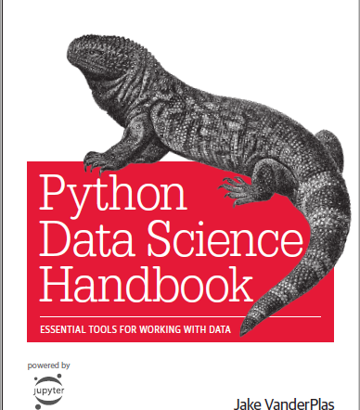
Python for Data Science
https://github.com/jakevdp/PythonDataScienceHandbook

Slide 2
Data Science with Python
Get Data
Data Pre-proc essing
Analysis And Modeling
Evaluate And Present
Beautiful Soup
LXML
Tweepy
Pandas
Pandas
NLTK
Scikit
Matplotlib
Numpy
Scipy
Sympy
Sklearn
Statsmodels
IPython
Bokeh
Flask

Slide 3
IPython
Interactive Python started in 2001 as an enhanced Python interpreter
Developed by Fernando Perez as “Tools for the entire life cycle of research computing”
If Python is Engine, IPython as the interactive control panel.
Closely tied with the Jupyter project which provides browser based notebook
Two modes
IPython shell (Anaconda prompt -> Ipython)
Jupyter notebook (Anaconda prompt -> jupyter ntoebook)

Slide 4
IPython features
Refer to online notebooks:
https://github.com/jakevdp/PythonDataScienceHandbook/blob/master/notebooks/01.00-IPython-Beyond-Normal-Python.ipynb

Slide 5
Data as numbers
Datasets can come from a wide range of sources and formats
E.g. documents, images, sound clips, numerical measurements
Data is fundamentally array of numbers
Digital images are 2D arrays of numbers representing pixel brightness across the area
Sound clips are 1D arrays of intensity versus time
Text can be converted in various ways into numerical representations
First step in making data analyzable is to transform it into arrays of numbers
Both, NumPy and Pandas package efficiently store and manipulate numerical arrays

Slide 6
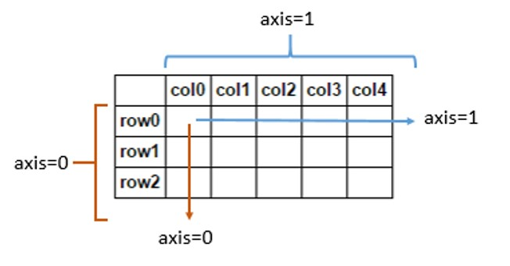
NumPy
Stands for Numerical Python
Efficient interface to store and operate on dense data buffers
NumPy arrays are similar to Python’s built-in list type, but provide much more efficient storage and data operations for larger arrays
Form the core of data science tools in Python

Slide 7
NumPy features
Refer to online notebooks:
https://github.com/jakevdp/PythonDataScienceHandbook/blob/8a34a4f653bdbdc01415a94dc20d4e9b97438965/notebooks/02.00-Introduction-to-NumPy.ipynb

Slide 8
Pandas
Built on top of NumPy and provides efficient implementation of a DataFrame
DataFrame is multi-dimensional array with attached row and column labels
DataFrame may contain data with heterogeneous types and/or missing data
Provides a number of powerful data operations using Series and DataFrame objects

Slide 9
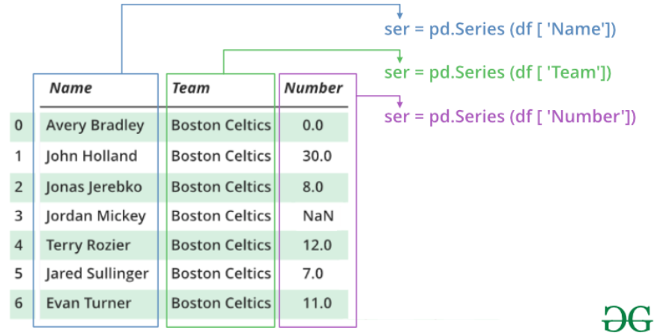
Pandas Series and DataFrame

Slide 10
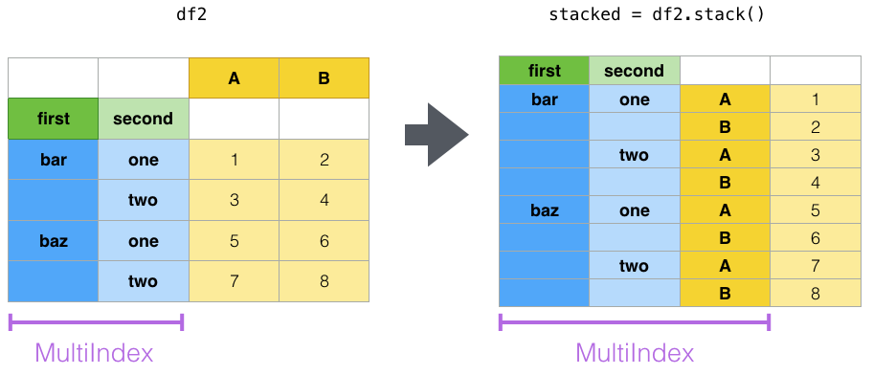
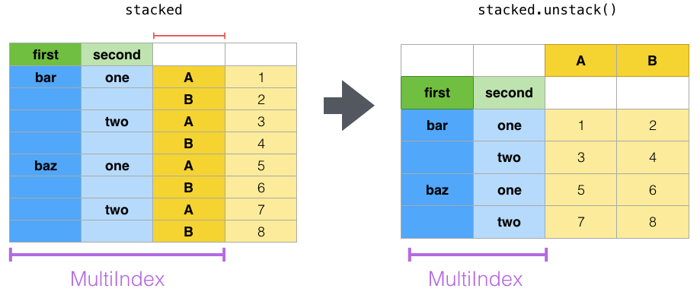
Pandas Stack vs Unstack
Convert a DataFrame into multiple indexed series
Convert a multiple indexed series into a DataFrame

Slide 11
Pandas features
Refer to online notebooks:
https://jakevdp.github.io/PythonDataScienceHandbook/03.00-introduction-to-pandas.html

Slide 12
Practice exercises for Midterm 2
NumPy exercises: https://www.w3resource.com/python-exercises/numpy/index.php
Pandas exercises: https://www.w3resource.com/python-exercises/pandas/index.php
I will try to come up with some exercises (but keep practicing above).

Slide 13
SciKit Learn
Provides efficient implementation of a large number of machine learning algorithms
Clean, uniform, streamlined API along with online documentation
Understand Scikit-Learn for one type of model and switch to other model effortlessly

Slide 14
SciKit Learn – Steps in using the API
Choose a class of model by importing the appropriate estimator class from Scikit-Learn.
Choose model hyperparameters by instantiating this class with desired values.
Arrange data into a features matrix and target vector following the discussion above.
Fit the model to your data by calling the fit() method of the model instance.
Apply the Model to new data:
For supervised learning, often we predict labels for unknown data using the predict() method.
For unsupervised learning, we often transform or infer properties of the data using the transform() or predict() method.

Slide 15
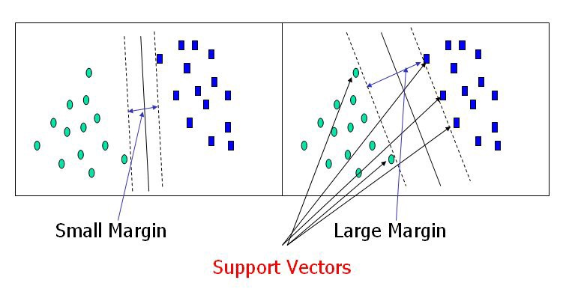
Support Vector Machines (SVM )
Powerful supervised algorithms for both classification and regression.
Mainly used to solve classification problems.
Algorithm creates a hyperplane or line which separates data into classes.
Uses the kernel trick to find the best line separator (decision boundary that has same distance from the boundary point of both classes).

Slide 16
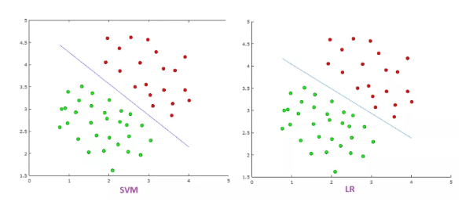
Difference Between SVM and Logistic Regression
SVM tries to finds the “best” margin that separates the classes and this reduces the risk of error on the data
Logistic regression can have different decision boundaries with different weights that are near the optimal point.
SVM works well with unstructured and semi-structured data like text and images.
Logistic regression works with already identified independent variables.

Slide 17
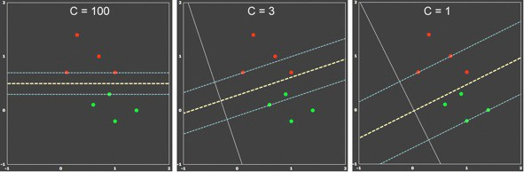
Significance of C Value in SVM
In SVM, we try to:
Set a lower margin
Lowering misclassification rate
Parameter C
Large value of parameter C => small margin
Small value of parameter C => large margin

Slide 18
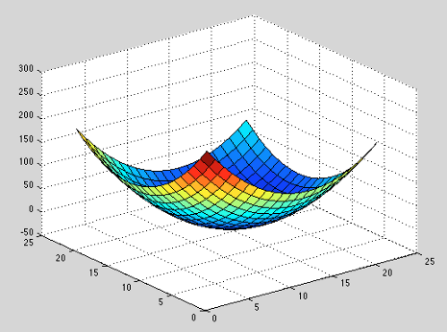
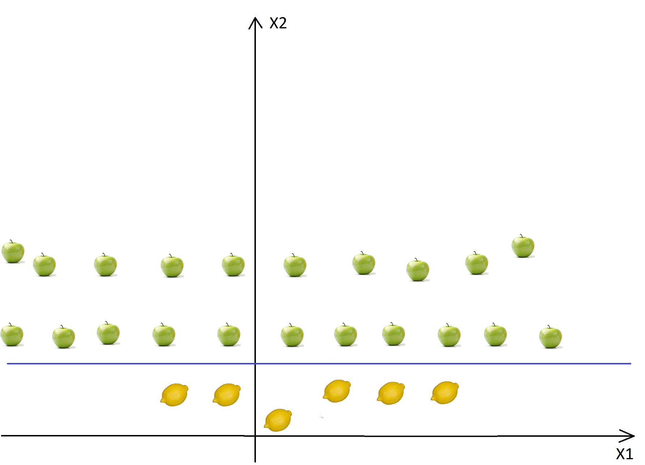
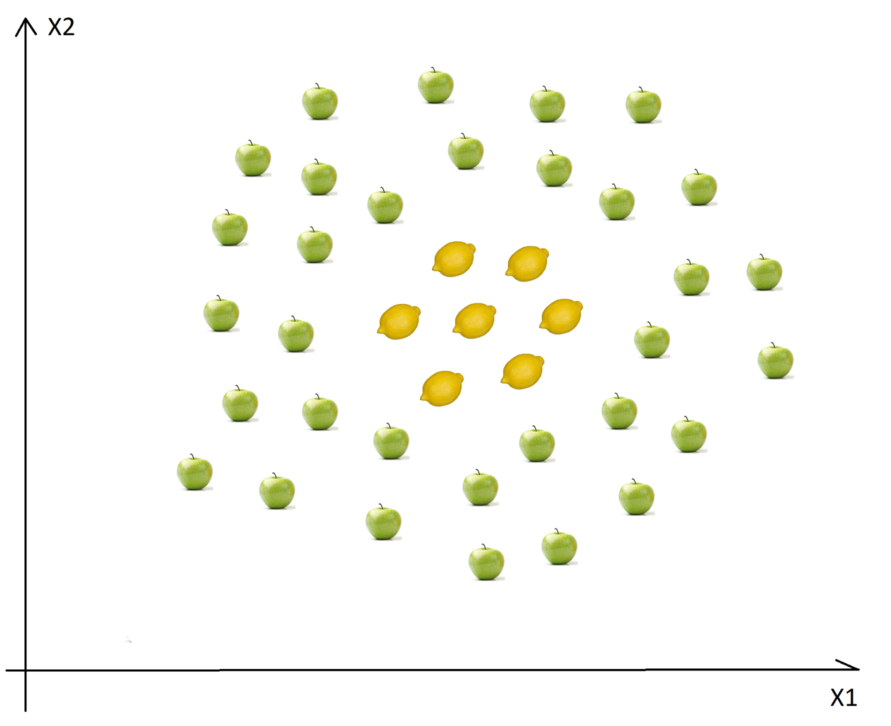
SVM and Kernel Trick
For non-linear datasets, we can not find a straight line. SVM uses kernel trick to solve this problem.
Basic idea is that add another dimension, maybe data will be seperable.
Another dimension can be added – for example based on distance.
Non-linear data
Mapping from 2D to 3D
Origin is lemon from center

Slide 19



SVM and Kernel Trick
Few types of kernels:
Polynomial kernel
Used for image processing
d is degree of polynomial
Gaussian kernel
General purpose kernel
Gaussian Radial Basis Function (RBF)
General purpose kernel
Some SVM links for reference:
https://towardsdatascience.com/svm-and-kernel-svm-fed02bef1200
https://data-flair.training/blogs/svm-kernel-functions/
https://medium.com/axum-labs/logistic-regression-vs-support-vector-machines-svm-c335610a3d16

Slide 20
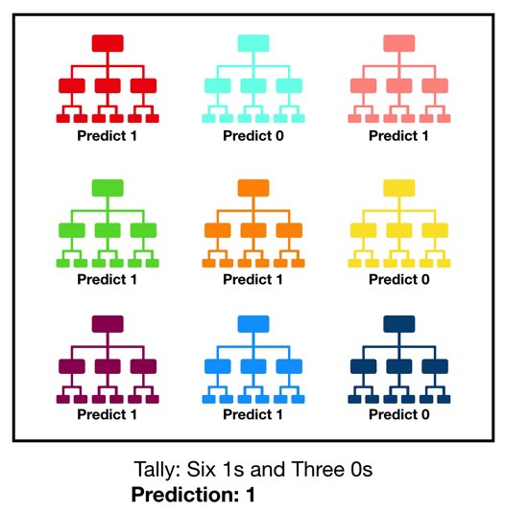
Decision Trees and Random Forests
Random forests are an example of an ensemble method
Relies on aggregating the results of an ensemble of simple estimators
A majority vote among a number of estimators can end up being better than an individual estimator

Slide 21
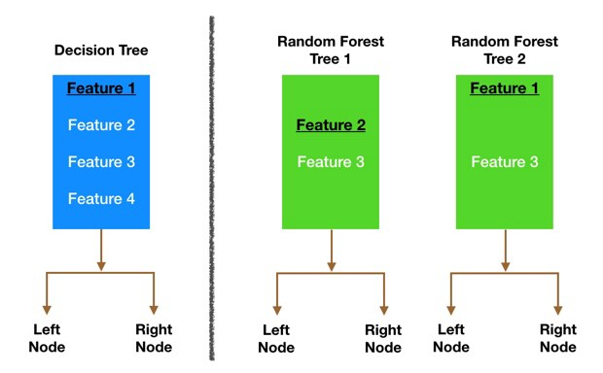
Random Forests: Ensuring that the Models Diversify Each Other
Bagging
Decision trees are sensitive to the training data
Allow each individual tree to randomly sample from the dataset with replacement, resulting in different trees
E.g. [1, 2, 3, 3, 5, 6], [1, 2, 3, 4, 6, 6]
Random subset of training points
Feature randomness
Each tree in a random forest can pick only from a random subset of features
Further info
https://towardsdatascience.com/understanding-random-forest-58381e0602d2

Slide 22
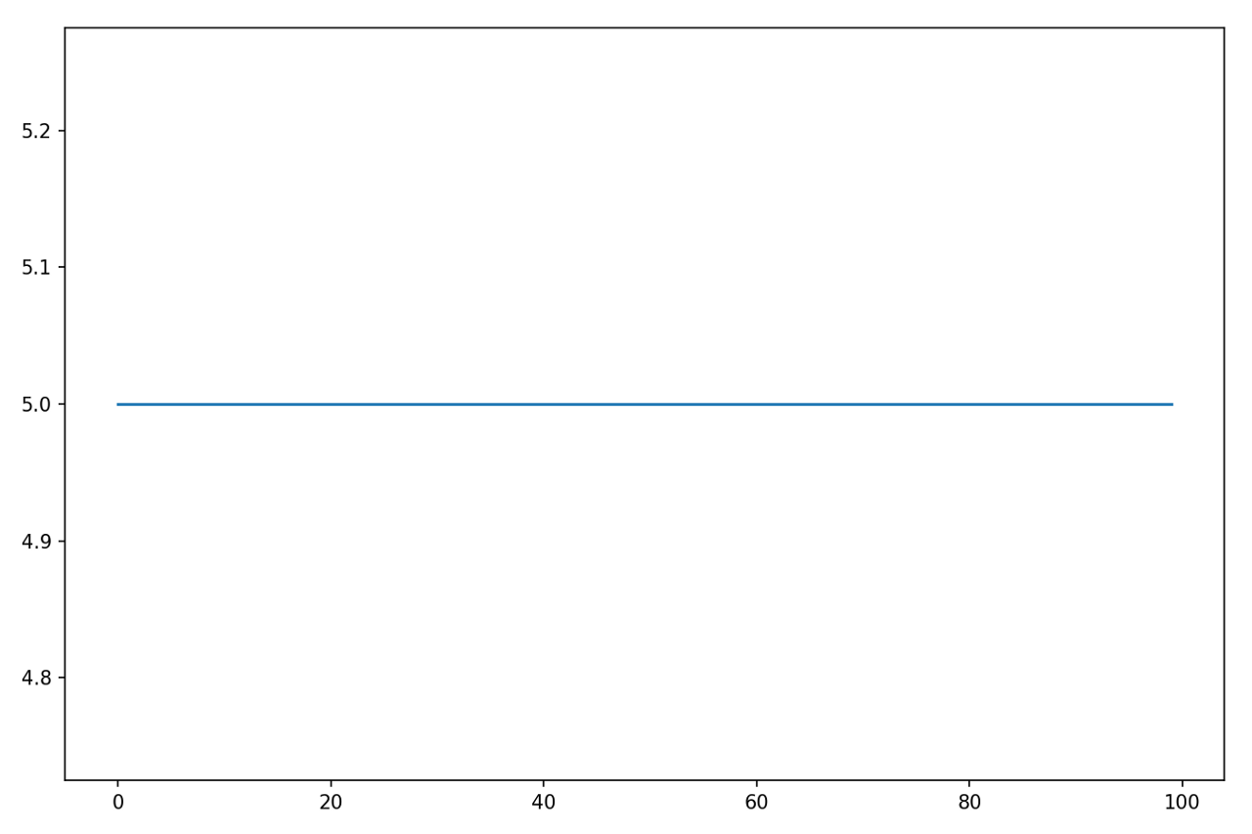
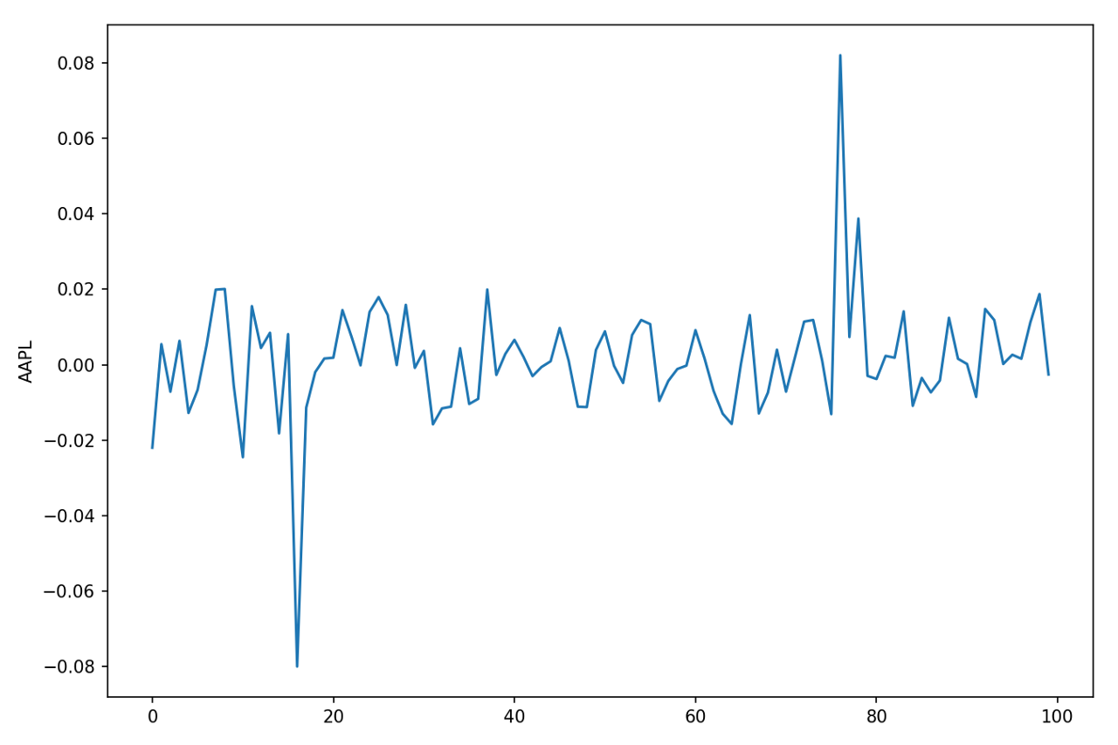
Principal Component Analysis (PCA)
Fast and flexible unsupervised method for dimensionality reduction in data
Fundamentally, a dimensionality reduction algorithm, but can also be used for visualization, noise filtering, feature extraction
Features with no variance vs features with high variance
Good model needs features with more variance
More variance creates uncertainty

Slide 23
Capturing Signal with Principal Components
Given data with 10,000 features and 5,000 observations is a terrible idea as it will result in massively overfit model
The ideal set of features should have following three properties:
High variance (contain a lot of potential signal – useful information)
Uncorrelated (Highly correlated features are less useful)
Require low number of features
PCA creates a set of principal components that are rank ordered by variance, uncorrelated and low in number
PCA finds strongest underlying trend in the feature set

Slide 24
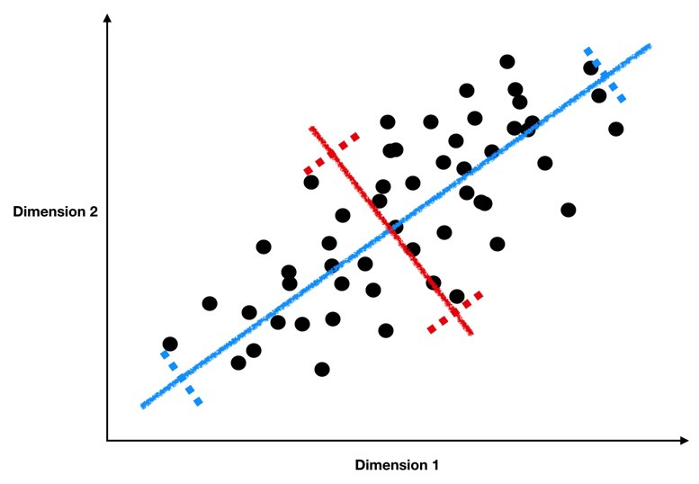
Capturing Signal with Principal Components
Data is black dots
Strongest trend is the line of best fit
Blue line is component 1 as it has the highest variance (compared to red)
Each principal component is a linear combination of individual features (similar to linear regression)
Component 2 should be uncorrelated to component 1 (orthogonal)
In this case, it is red line!
More information: https://towardsdatascience.com/understanding-pca-fae3e243731d

Slide 25
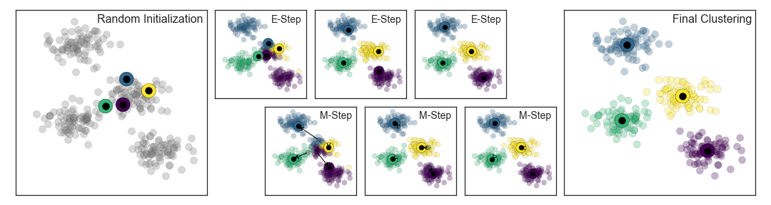
K-Means Clustering: Expectation - Maximization
The expectation–maximization approach here consists of the following procedure:
Guess some cluster centers
Repeat until converged
E-Step: assign points to the nearest cluster center
M-Step: set the cluster centers to the mean

Slide 26
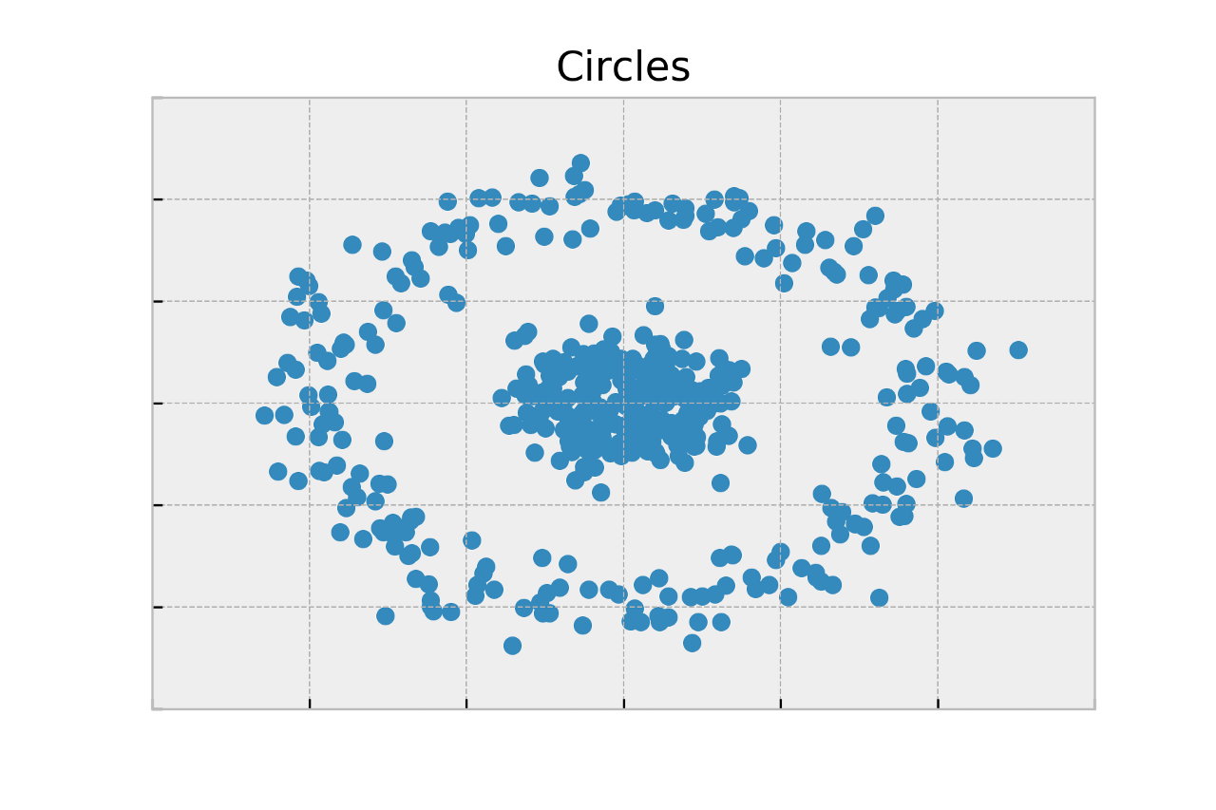
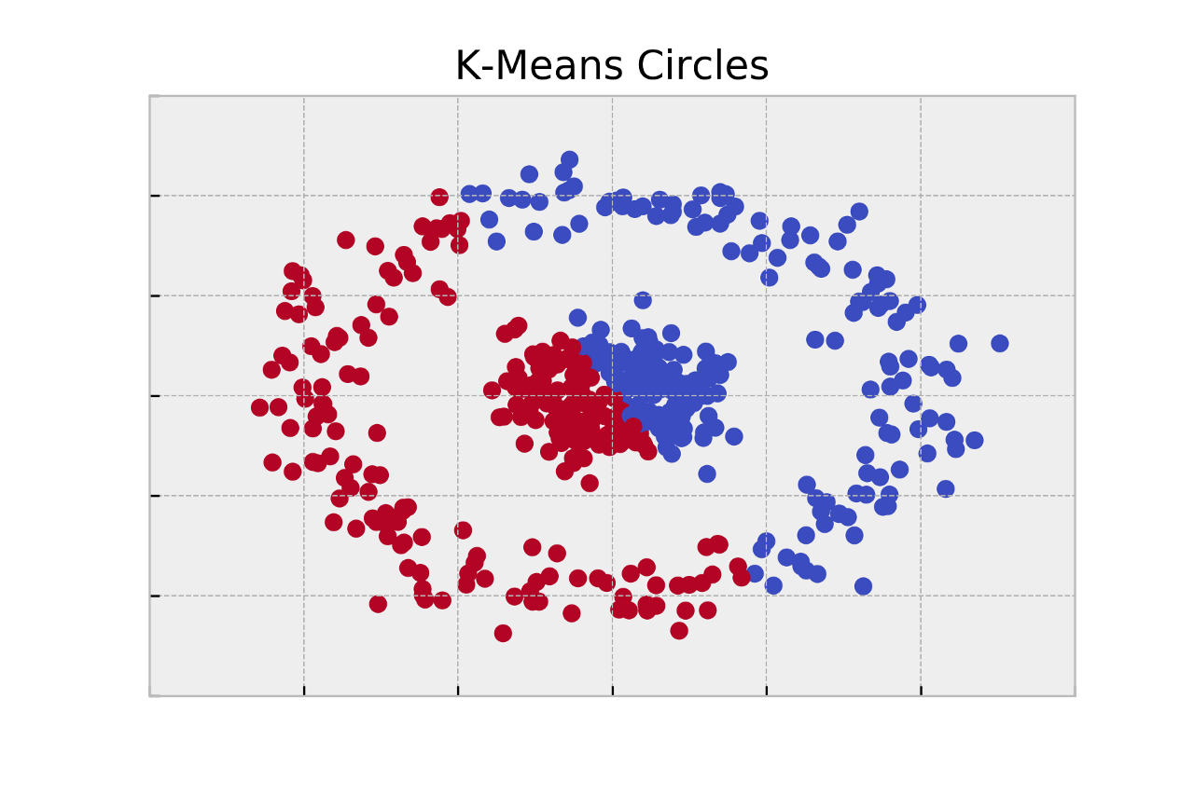
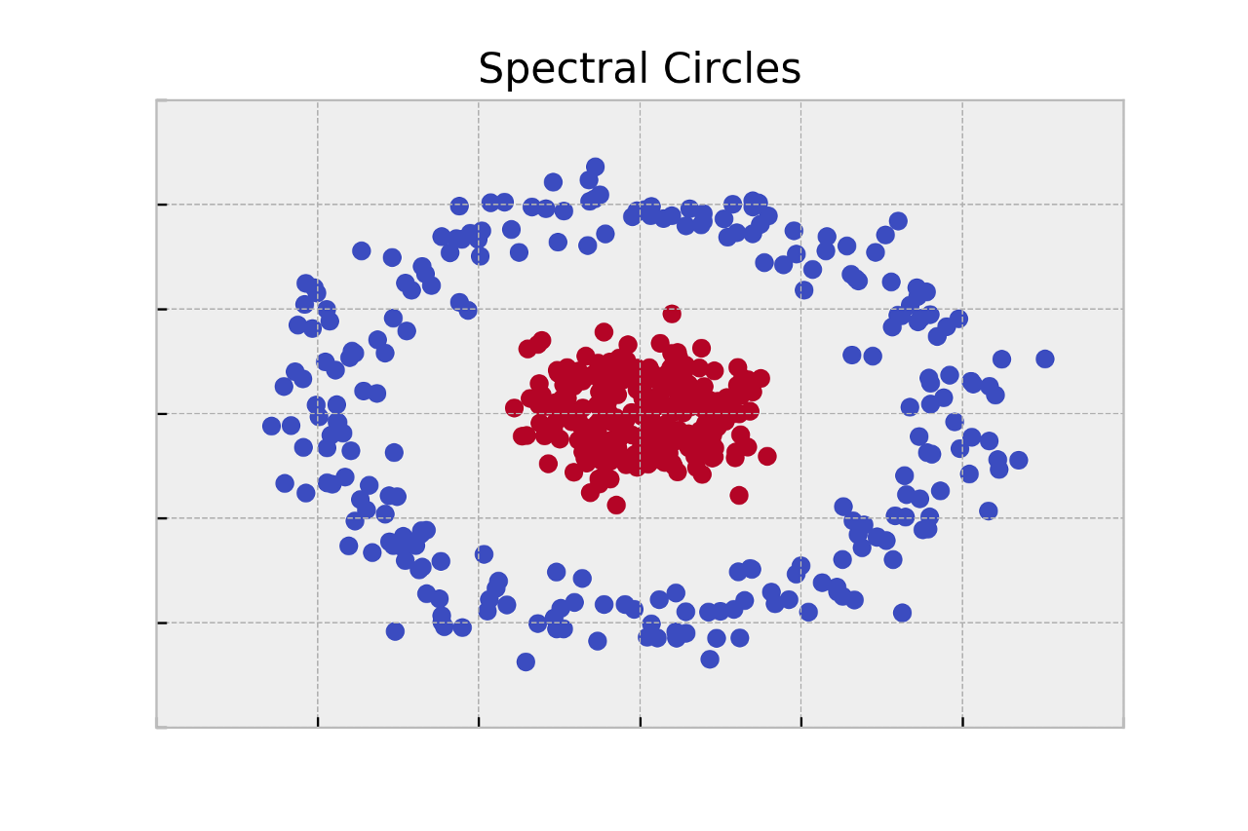
K-Means Clustering: Spectral Clustering
K-Means clustering is limited to linear cluster boundaries
K-Means fails to find clusters with complicated geometries
Solution: use approach similar to kernel tricks in SVM
E.g. SpectralClustering uses graph of nearest neighbors to compute higher-dimensional representation and assign labels using K-Means
More details: https://towardsdatascience.com/spectral-clustering-aba2640c0d5b

